Slide 1
February 22, 2024 College information for Juniors 6:00-6:40pm Running Start Information 6:45-7:30pm
Welcome!
Please have a seat. We will be starting shortly. There will be a Q & A session at the end of each segment.
*This slide deck will be available soon on the CHS counseling web page
https://www.chs.rsd407.org/counseling
Notes:
Ellie
Welcome, thank you for coming tonight. Explain how the night will go, with questions after each session

Slide 2
Our Team
Counselors
Aaron Clifford: A-G, (clifforda@rsd407.org)
Margaret Russ: H-Pa (russm@rsd407.org)
Ellie Prussing: Pe-Z (prussinge@rsd407.org)
College and Career Center
Wendy Scott: College & Career Readiness Specialist (scottw@rsd407.org)
Counseling staff
Cindy Stout, Counseling Secretary (stoutc@rsd407.org)
Sharla Hall, Registrar (HallSh@rsd407.org)
Notes:
Ellie
Introduce us all. Best and quickest way to get ahold of us is email.

Slide 3
Agenda
Post High School Pathways
College Search / building your list
How to apply
Elements of the College Application
High School and Beyond Plan – Graduation Requirement!
Financial Aid and Scholarships
Junior Conferences
Questions
Notes:
Ellie

Slide 4
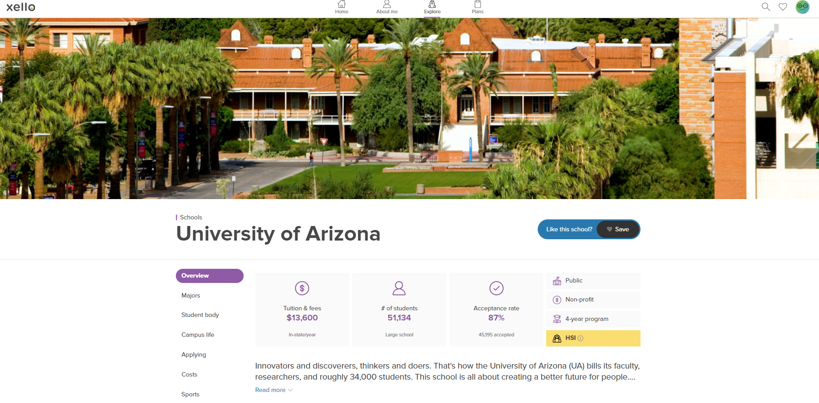
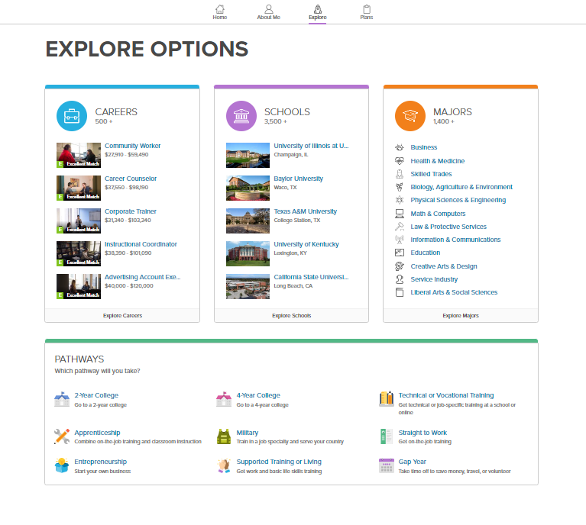
Post-High School Pathways
Apprenticeship/Job Training
2–4-year Community/Technical College
4-year College/University
Military
Parent access to Xello.
Check out the CHS College & Career web page for lots of resources!
Explore options in Xello.
Research online.
Go to college fairs. Speak to college & military representatives that visit our school.
Start to actively learn more about the schools & majors that interest you!
xello.world
Notes:
Ellie

Slide 5
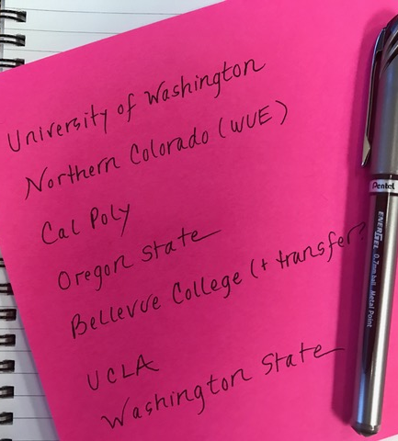
Building your list
Mix of likely, target, and reach schools
Mix of academic, social, and financial fit schools
Student should be HAPPY to attend any school on the list
Considerations:
Academic Fit – major, learning environment, research, class size, entrance requirements
Social Fit – location, size, clubs, sports, housing, Greek system, values
Financial Fit – estimate costs using schools net price calculator, schools where students are at the top of the academic ranges where merit money may be more likely
Notes:
Margaret
Don't just go for the schools you have heard of – do some investigating. Find the right fit for YOU. Sports, Greek System, Size of School – proximity to home
Spreadsheet – keep a log of target schools
Track key data and requirements – deadlines

Slide 6
Advice for Students
Do
Do your research
Keep
Keep track of deadlines and dates
Check
Regularly check emails once you start the process
Use
Use professional communication
Proofread
Proofread, proofread, proofread!
Screen
Screen your social media
Notes:
Margaret
check your email address – is it professional? Do not use your RSD email. Consider a new email address to use solely for college app’s and check it frequently. Scrub SM of anything you don’t want admission counselors to see.

Slide 7
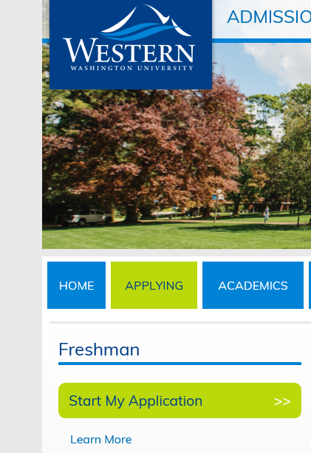
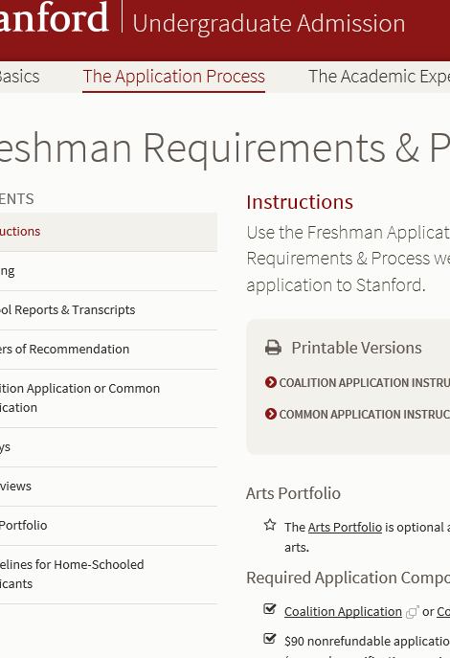
HOW TO APPLY
Check College’s website
Common Application​
University of California/Cal State each have their own application​
Notes:
Margaret Each college has its own application/admission requirements.

Slide 8
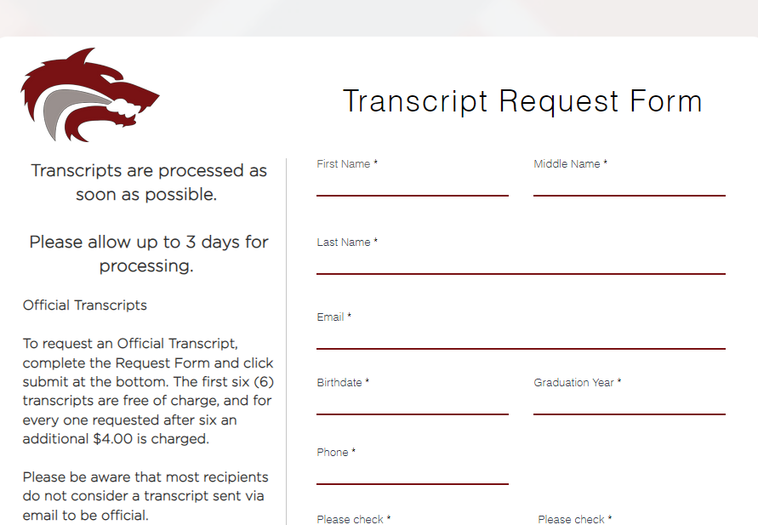
Transcripts
Check college’s web site under admissions for transcript requirements​
Common Application transcripts are automatically submitted by Counselors​ if invited
Some schools require you to mail a transcript. Please complete a transcript request form available on the CHS Counseling webpage
https://www.chs.rsd407.org/transcript
Some schools do not require a transcript until after admitted and enrolled (UW, University of California)
Notes:
Margaret - Check when needed. Request form online through counseling page.

Slide 9
ELEMENTS OF A COLLEGE APPLICATION
Holistic Review
Rigor
GPA
ACT/SAT Scores - All WA public colleges are now test optional
Extracurriculars - leadership, sports, clubs, community service, part-time jobs, summer enrichment
Essays – if needed, look up prompts and work on it this summer
Recommendations – if needed, Letter of Recommendation Form can be found on our counseling site.* Ask early! (even this semester or a minimum of 4 weeks before you need it!)
*https://www.chs.rsd407.org/counseling
Notes:
Margaret
All Washington Public Colleges are Test Optional or Test not required
do your best, be honest, and follow the deadlines as well as the word count.

Slide 10
Graduation Requirements
24 Credits
Graduation Pathways - SBA; CTE Sequence; Dual Credit; ASVAB
High School and Beyond Plan (Xello)
Washington State History
Notes:
Aaron
Mention different pathways. Students need to look in Skyward themselves and see their graduation requirements and register accordingly for senior year. Do their Xello lessons, elaborate on next slide

Slide 11
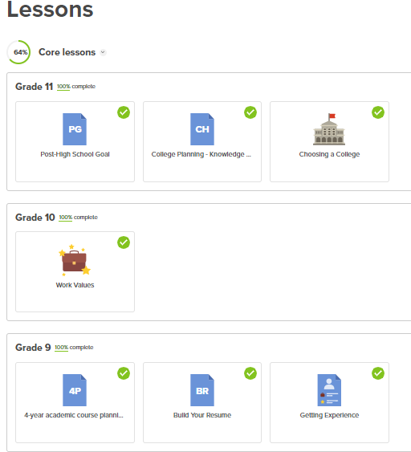
High School and Beyond Plan
WA state graduation requirement
Completed in Xello
Login through www.office.com and choose the Xello app.
Complete ALL Core Lessons for grades 9th-12th (lesson for 12th grade will open next year).
Notes:
Aaron
Complete all Xello lessons. Do lessons at the start of the school year

Slide 12
College Academic Distribution Requirements (CADRs)
Required for Washington 4-year public colleges
All college freshman applicants must complete a minimum level of preparation in six subject areas
4 credits English
3 credits of Math through Algebra 2*
3 credits of Science including 2 years of lab science*
3 credits of social science
2 credits of World Language
*1 credit in Senior Year of a math-based quantitative course (fulfilled if pre-calc taken)
1 credit of Fine, visual or performing arts
Note, these are the minimums. If you’re wanting to attend a competitive college, they may recommend more credits.
Notes:
Aaron- Mention class choices for CADR’s Senior Year quantitative requirement. Note these are only minimums. Some colleges require more, check their website or common data set.

Slide 13
FINANCIAL AID
Financial aid is money to help pay for college or career school. Grants, work-study, loans, and scholarships help make college affordable.
*Apply for Financial Aid by using the Free Application for Federal Student Aid (FAFSA) if you are a U.S. citizen or eligible non-citizen OR the WAFSA (but not both!)
Scholarships
Check the CHS College & Career web page
www.chs.rsd407.org/collegeandcareer
Start searching NOW!
Sources include employers, banks and credit unions, local businesses, civic groups, organizations related to your field of interest
Examples of Search Engines:
thewashboard.org
fastweb.com
scholarships.com
Use Google
Snoqualmie Valley Dollars for Scholars
Opens in February of Senior year.
Over 50 scholarships JUST for Cedarcrest Seniors!
ALL SENIORS should apply!
Applications OPEN October 1st of Senior Year.
Class of 2025 will use the 2025-2026 FAFSA
The sooner you apply, the better!
Must complete for each year of college
Notes:
Wendy - All families should apply for financial aid. Opens October 1st Senior year and every year in college. Don’t just write it off as yyou make too much. Some scholarships go through FAFSA. FAFSA/WASFA online completion events online through WSAC. Reach out to Financial Aid Office for help. Start looking now for scholarships. Specific interests, use Google

Slide 14
Junior Conferences
in the College & Career Center
Happening NOW!
Post-high school planning
Students called from class alphabetically
If students want an appointment, email Wendy Scott scottw@rsd407.org
Complete core lessons in Xello for 9th-11th grade
Notes:
Wendy - Go over what their plan for after high school, share some tools for students to research and actively plan their future whether trade school, apprenticeships, college (Students should take time to visit college websites. ), career. Xello, Big Future, CHS CCC web page and counseling. Complete by Spring Break

Slide 15
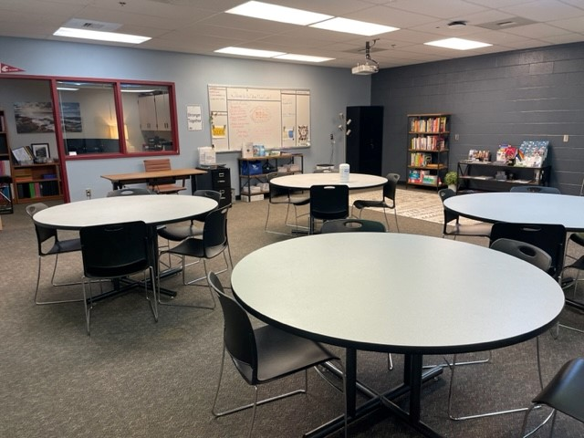
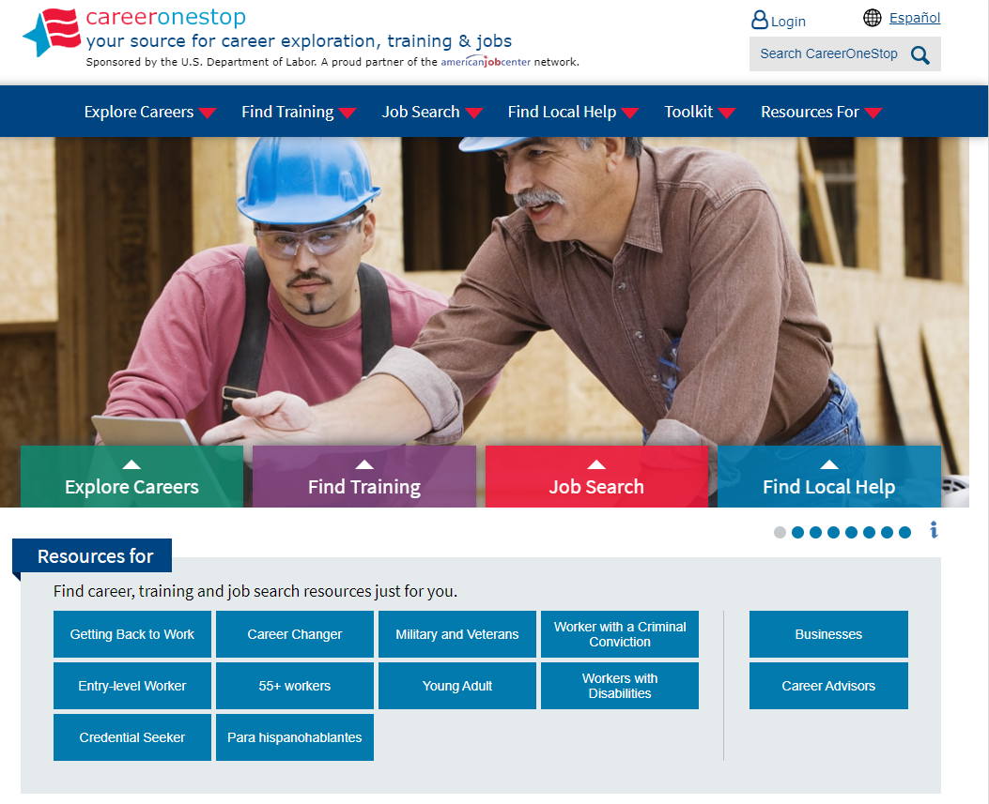
Students are Welcome to visit the College & Career Center (in Room 111) before and after school and during lunches. No appointment needed! Visit chs.rsd407.org/collegeandcareer for info on planning careers, college, apprenticeships, financial aid, & more!
Follow us on Instagram for College & Career tips, events, scholarships, and more!
instagram.com/chscollegeandcareercenter
Wendy Scott
College & Career Readiness Specialist
scottw@rsd407.org
Notes:
Wendy - I’m a resource for students for all things post-high school. College applications, job opportunities, military recruiters. More than welcome to drop-in or email for an appointment.

Slide 16
Questions?
Ques
Thank you!
The Running Start Information Session will start at 6:45
Notes:
Wendy - Thank you for coming out. Running Start will start shortly.

